Slide 1
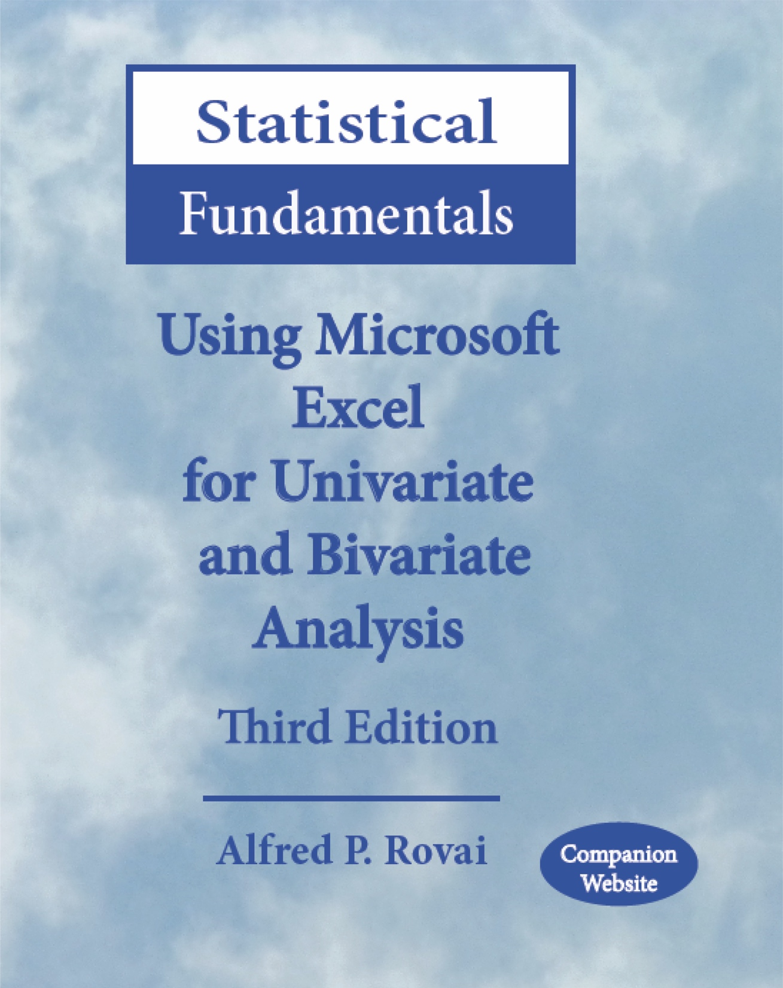
Statistical Fundamentals: Using Microsoft Excel for Univariate and Bivariate Analysis Alfred P. Rovai
Pearson Product-Moment Correlation Test
PowerPoint Prepared by Alfred P. Rovai
Microsoft® Excel® Screen Prints Courtesy of Microsoft Corporation.

Slide 2
Pearson Product-Moment Correlation Test
The Pearson product-moment correlation test (also known as Pearson r) is a parametric procedure that determines the strength and direction of the linear relationship between two continuous variables.
Pearson r is symmetric, with the same coefficient value obtained regardless of which variable is the IV and which is the DV. It has a value in the range –1 ≤ r ≤ 1. The absolute value of Pearson r can be interpreted as follows:
Little if any relationship < .30
Low relationship = .30 to < .50
Moderate relationship = .50 to < .70
High relationship = .70 to < .90
Very high relationship = .90 and above

Slide 3
Pearson Product-Moment Correlation Test
Excel data entry for this test is fairly straightforward. Each variable is entered in a sheet of the Excel workbook as a separate column.
Pearson r is calculated as follows using raw scores.
The following Excel function is used:
PEARSON(array1,array2). Returns the Pearson product-moment correlation coefficient, where array1 and array2 represent the range of numbers for each variable.

Slide 4
Pearson Product-Moment Correlation Test
The p-level for this correlation coefficient can be calculated using the t-distribution and the following t-value.
The degrees of freedom for this test are N− 2, where N is the number of cases in the analysis.
The following Excel function is used to determine the p-level:
T.INV.2T(probability,deg_freedom). Returns the inverse of the t-distribution (2-tailed), where probability is the significance level and deg_freedom is a number representing degrees of freedom.

Slide 5
Key Assumptions & Requirements
Random selection of samples to allow for generalization of results to a target population.
Variables. Two interval/ratio scale variables.
Absence of restricted range. Data range is not truncated in either variable.
Measurement without error.
Bivariate normality. The scores on one variable are normally distributed for each value of the other variable, and vice versa. Univariate normality of both variables does not guarantee bivariate normality.
Absence of extreme outliers. Pearson r is very sensitive to outliers. A nonparametric test should be used if outliers are detected.
Independence of observations.
Homoscedasticity. The variability in scores for one variable is roughly the same at all values of a second variable.
Linearity. There is a linear relationship between the two variables.

Slide 6
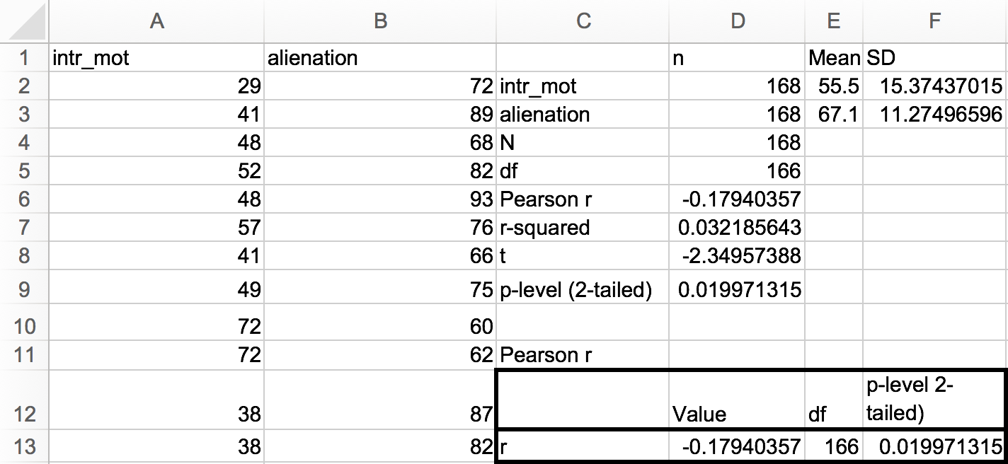
Conducting the Pearson Product-Momemt Correlation Test
Open the dataset Motivation.xlsx. Click on the Pearson r worksheet tab.
File available at http://www.watertreepress.com/stats
TASK
Respond to the following research question and null hypothesis:
Is there a relationship between intrinsic motivation (intr_mot) and alienation among online university students?
H₀: There is no relationship between intrinsic motivation and alienation among online university students.

Slide 7
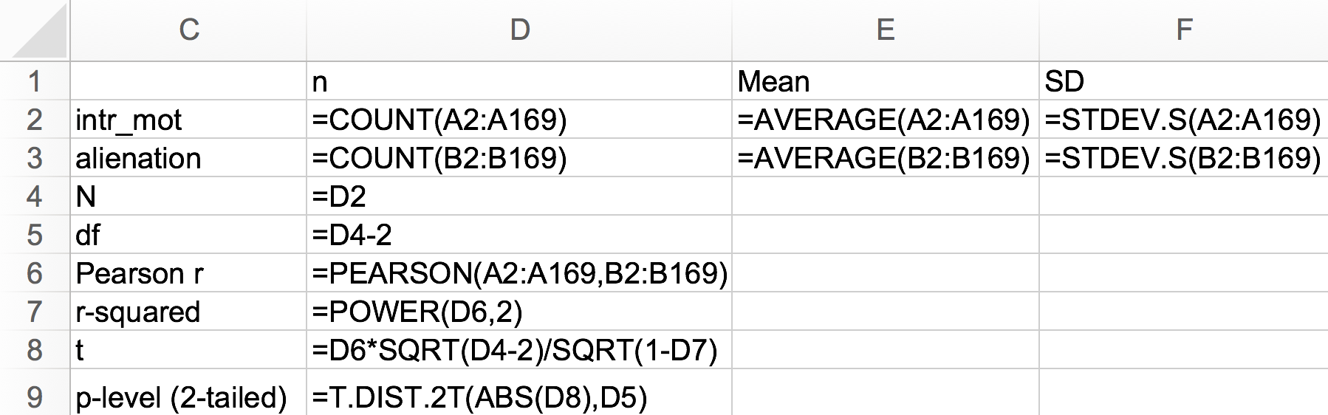
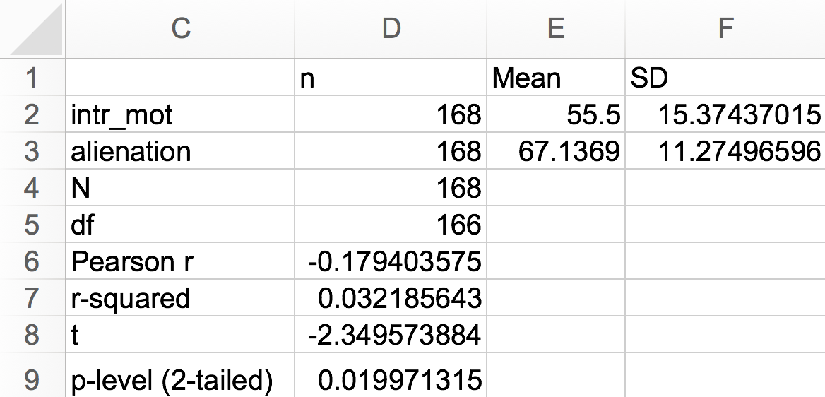
Conducting the Pearson Product-Momemt Correlation Test
Enter the labels and formulas shown in cells C1:F9 in order to generate appropriate statistics.
The results of the test provide evidence that intrinsic motivation (M = 55.50, SD = 15.37) is inversely related to alienation (M = 67.14), SD = 11.27), r(166) = –.18, p =.02 (2-tailed). Therefore, there was sufficient evidence to reject the null hypothesis. The coefficient of determination was .03, indicating that both variables shared only 3 percent of variance in common, which suggests a slight but significant relationship.

Slide 8
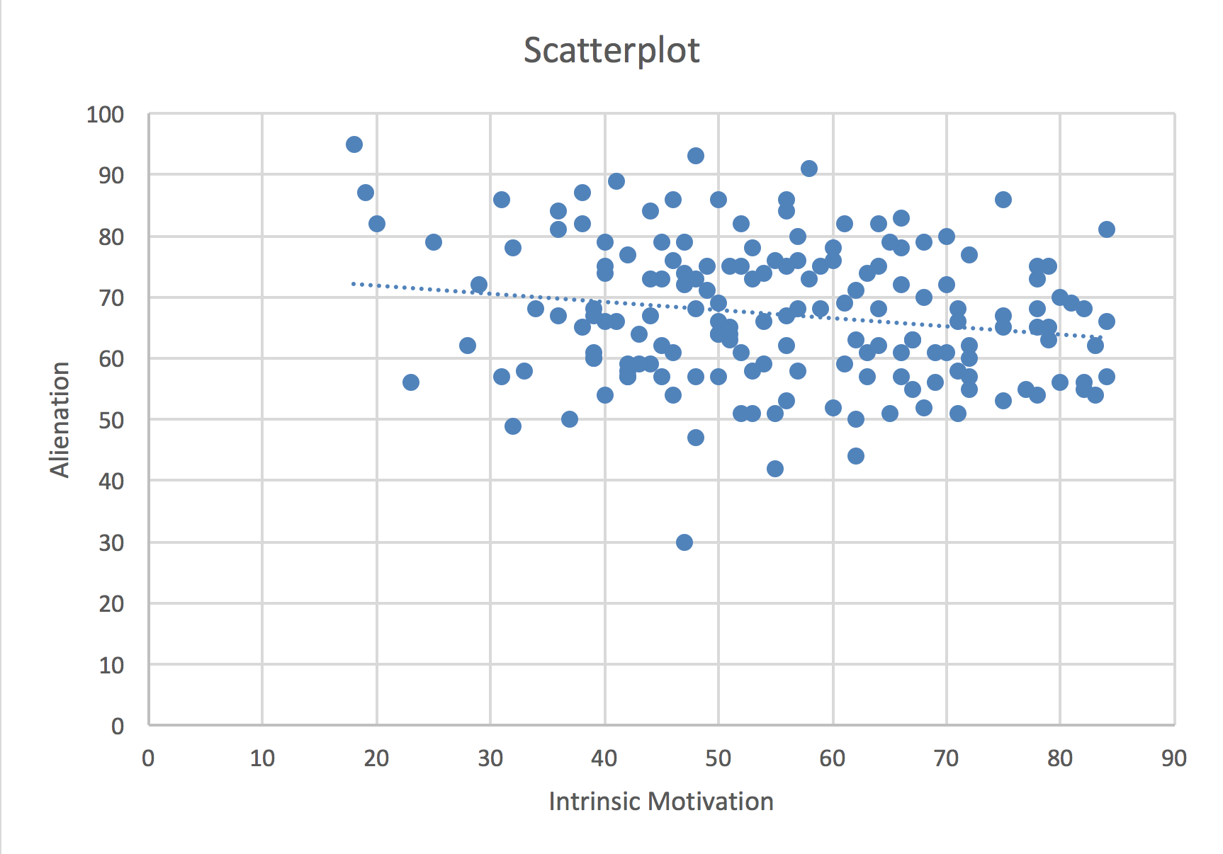
Scatterplot
The scatterplot shows a slight, negative relationship between intrinsic motivation and alienation.
The trendline with negative slope shows a negative relationship (as one variable increases, the other decreases).
The dispersed plots suggests a slight relationship (r(166) = –.18).

Slide 9
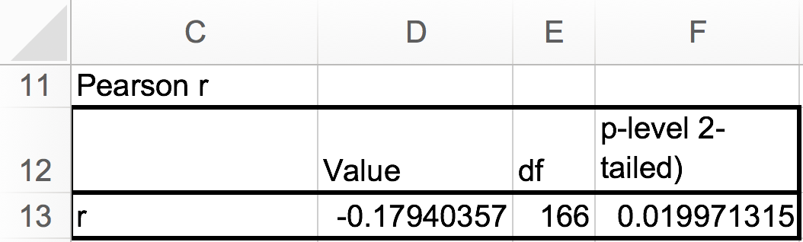
Test Results Summary
Test results provide evidence that there is sufficient evidence (p = 0.02) to reject the null hypothesis that there is no relationship between intrinsic motivation and alienation.

Slide 10
Reporting Pearson Product-Moment Correlation Test Results
As a minimum, the following information should be reported in the results section of any report: null hypothesis that is being evaluated, descriptive statistics (e.g., M, SD, N), statistical test used (i.e., Pearson product-moment correlation test), results of evaluation of test assumptions, as appropriate, and test results. One might also include a figure of a scatterplot displaying the strength and direction of relationship between the two variables. The formatting of the statistics in this example follows the guidelines provided in the Publication Manual of the American Psychological Association (APA).
Results
The Pearson product-moment correlation test was conducted to evaluate the null hypothesis that there is no relationship between intrinsic motivation and alienation among online university students (N = 168). The results of the test provided evidence that intrinsic motivation is inversely related to alienation, r(166) = –.18, p =.02 (2-tailed). Therefore, there was sufficient evidence to reject the null hypothesis. The coefficient of determination was .03, indicating that both variables shared only 3 percent of variance in common, which suggests a slight relationship.

Slide 11
Pearson Product-Moment Correlation Test
End of Presentation

